Slide 1

ASSOCIATED/UNITED STUDENT BODY TRAINING FOR ADMINISTRATION & ACTIVITY DIRECTORS
Presented by Tony Carrillo and Lesley Nichols
Notes:
Good afternoon – thank you for attending. This virtual format seems to be more convenient to everyone and we are getting more participation. This presentation has a few updates from last year’s version. The largest change is that Lesley Murray is the new Accounting Supervisor. This presentation is available on the Business Services web site. We have an hour to go over 35 slides. There will be time to take questions or we will stay later if you want. We are always available to support you as well. This year there could be some new questions or opportunities to accomplish the ASB activities.

Slide 2
Purpose For Workshop
Answer questions in areas of the Associated Student Body (ASB)/United Student Body (USB) roles and responsibilities related to management level positions.
Discussion on good practices and top down approach.
Discussion on the dos and don'ts of ASB/USB.
Discussion of District responsibility versus Site responsibility.
Notes:
These are important concepts that need to be reviewed. I have been doing this for so long that I assume that everyone else will know the same information. You recall that saying about assuming anything. Today we will take our time and explore these areas. All of this information is from the FCMAT (Fiscal Crisis and Management Assistance Team) ASB handbook which is considered the got to guide. The hard copy version indicates that is was from 2015 which could imply it is out of date and there is a new version. There actually has not been any new rulings and the data is current. You can get the hard copy or download onto your computer like I do. Easy reference that will answer most of your questions.

Slide 3
Biggest Issue Affecting ASB/USB
What is the biggest issue affecting ASB/USB?
Management of ASB/USB funds and operations.
Most ASB/USB funds are received in cash. What are the problems that are associated with this?
Fraud
Abuse / Waste
Human Error
What is put into place to fight fraud, abuse, waste and human error?
Notes:
We all are interested in supporting the ASB/USB programs for the student’s benefit. There are many opportunities to enrich the student’s experience at our campuses. This presentation is the technical review of the business and administration of the ASB/USB.

Slide 4
Roles and Responsibilities
The governing board of the district is ultimately responsible for everything that happens in the district, including the activities of student organizations.
Notes:
This concept is important. Everyone of us up to the board members is responsible for the fiscal activities of the ABS/USB. We cannot delegate that responsibility away. So, we all need to educate ourselves, support the different participants with the correct information and do some routine sanity checks. I have the fiduciary responsibility or oversight.

Slide 5
Organized ASB/USB
The site administrator is responsible for the following major duties:
  Communicating the student organization policies and procedures to the staff and students, and enforcing the policies and procedures.
  Ensuring that a student council is established and that each club has a certificated advisor.
  Providing supervision to the ASB/USB advisors.
  Reviewing and approving constitutions for each club on campus and making certain that minutes meet the FCMAT ASB manual guidelines and are kept of all ASB/USB and club meetings.
Notes:
Let’s start at the top – the principal! The principal is responsible for all of these tasks. They may delegate the task to an assistant principal but still the buck does stop at the top.

Slide 6
Organized ASB/USB
(continued)
  Providing supervision to the ASB/USB bookkeeper or similar position. This position will perform site financial tasks related to ASB/USB, maintain adequate records of ASB/USB activities, deposit funds into the bank, pay invoices, reconcile monthly bank statements, and prepare monthly financial statements.
  Ensuring that all ASB/USB funds are raised and spent in accordance with applicable laws and the school’s policies and procedures.
  Deciding how many fund-raising events will be held each year and ensuring that they are appropriate for the students and the community.
Notes:
This year the fund raising events and activities will be a new challenge. I don’t know if there is any collaboration among the schools for ideas.

Slide 7
Organized ASB/USB
(continued)
  Scheduling and receiving proper approval for fund-raising events.
  Working with the business office regarding training, implementation of good business practices, internal controls and resolution of audit findings.
  Reporting any suspected fraud or abuse to the business office.
  See pages 6 – 12 of the FCMAT ASB Manual for roles and responsibilities.
    http://fcmat.org/2015-asb-accounting-manual-fraud-prevention-guide-and-desk-reference/

Slide 8
Unorganized ASB
The site administrator is responsible for the activities at the school as the students do not govern themselves, so the site administrator is responsible for all ASB activities including the following major duties:
  Assigning and supervising a school staff member to perform school financial tasks related to ASB.
  Receiving and reviewing the monthly bank reconciliation.
  Deciding how many fundraising events will be held each year.

Slide 9
Unorganized ASB
(continued)
  Making decisions about how the funds raised will be spent.
  Ensuring that all ASB funds are raised and spent in accordance with applicable laws and the district’s policies and procedures.
  Working with district’s business office to provide training, implement good business practices, ensure internal controls and resolve audit findings.

Slide 10
General Business Practices and Internal Controls
Chapter 5
The basic components of internal controls:
  Segregation of duties
  System of checks and balances
  Staff cross training
  Use of pre-numbered documents
  Asset security
  Timely reconciliations
  Inventory records
  Comprehensive annual budget

Slide 11
Budgets and Budget Management
Chapter 6
Budgets are usually prepared for a one-year period. The general student council and each individual club should develop a budget document with their annual goals and a plan for achieving those goals by deciding the following:
  Estimated revenues: What fund-raisers will we have?
  Estimated expenses: What will the fund-raisers cost us to hold?
  Estimated ending reserves and club carryover: Is there enough left over to accomplish the goals we’ve outlined?

Slide 12
Budgets and Budget Management
Chapter 6, (continued)
Carryover of Unexpended Balances
The site administrator, advisor and students should ensure that the funds raised by students during a given school year are spent on behalf of those students while they are at the same school site.

Slide 13
Accounting and Financial Management
Chapter 7
Types of Financial Reports
Site Administrator: The site administrator must review and sign for approval all financial reports throughout the year and ensure that all required reports and submissions are made to the District’s business office as requested.
Student: The student council must approve and enter into the minutes the monthly and annual financial reports.

Slide 14
Accounting and Financial Management
Chapter 7, (continued)
Bank Accounts
  Accounts are approved by the PSUSD Board of Education
  Require two signatures on all checks
  Have account reconciled by someone who doesn’t keep the check register
  Deposits made on a regular basis
  Name of ASB/USB organization
Do NOT commingle funds.
  No PTA/Booster/Foundation money
  No personal funds
Do NOT deposit ASB/USB funds in personal account.

Slide 15
Allowable and Questionable Expenses
Chapter 14
Examples of Prohibited Purchases
Salaries or supplies that are the responsibility of the district.
Repair and maintenance of district-owned facilities and equipment.
Articles for the personal use of district employees.
Expenses for faculty meetings.
Expenses for parent-teacher organizations such as the PTA or boosters.
Large awards, unless board policy states otherwise.
Gifts of any kind including gift cards/certificates.

Slide 16
Allowable and Questionable Expenses
Chapter 14, (continued)
Examples of Prohibited Purchases (Continued)
Employee appreciation meals (unless approved by student council and noted in meeting minutes).
Employee clothing/attire.
Donations to other organizations, except in special circumstances.
Donations to families or students in need, no matter how worthy the cause may seem.
Cash awards to anyone including gift cards/certificates, because internal controls cannot be established and documented.

Slide 17
Allowable and Questionable Expenses
Chapter 14, (continued)
Gift of Public Funds
Discussions regarding gifts often conclude that trivial or insignificant gifts are acceptable. However, given modern governmental accounting practices and regulations, conflict of interest law and criminal law, FCMAT’s recommendation is that such expenditures of public funds or use of public funds in any amount can never be considered trivial or insignificant. The law clearly regards the misappropriation of public funds as a criminal act, with no minimum monetary limit specified, so it is best to avoid gifts of any amount.

Slide 18
Allowable and Questionable Expenses
Chapter 14, (continued)
Donations from Others
Have ASB/USB executive council acknowledge/accept gifts and donations and record in minutes.
Notify Kris Murphy in Business Services at (760) 883-2710 ext. 4806052 or kmurphy4@psusd.us on all donations.
Types of donations:
  Cash, Equipment, Supplies
  Make sure you want it and it is acceptable to Risk Management
Notes:
Added “on all donations”

Slide 19
Allowable and Questionable Expenses
Chapter 14, (continued)
Scholarships
The ASB/USB executive council may accept scholarships and trusts from outside donors (individuals or organizations) with the approval of the governing board or authorized designee.
These funds should be accounted for separately in a trust account within ASB/USB and used specifically for scholarships.

Slide 20
Allowable and Questionable Expenses
Chapter 14, (continued)
Scholarships
Cash awards issued by the ASB/USB are not allowed to be issued directly to the recipient; rather, scholarship checks shall be made payable to an institution of higher learning or a college bookstore, to be used toward tuition or books and supplies.

Slide 21
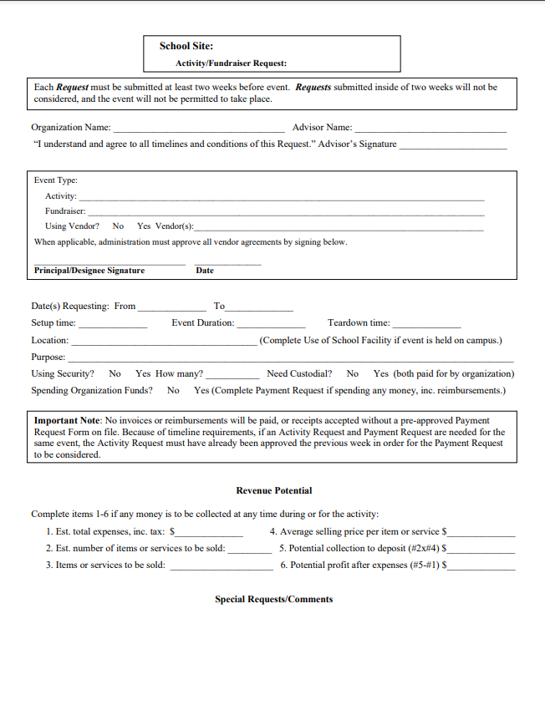
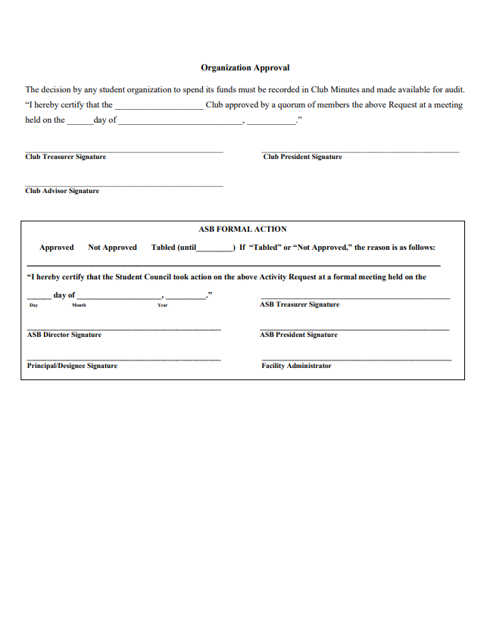
Activity Requests – Organized ASB
Activity Request Form
Tutorial Video

Slide 22
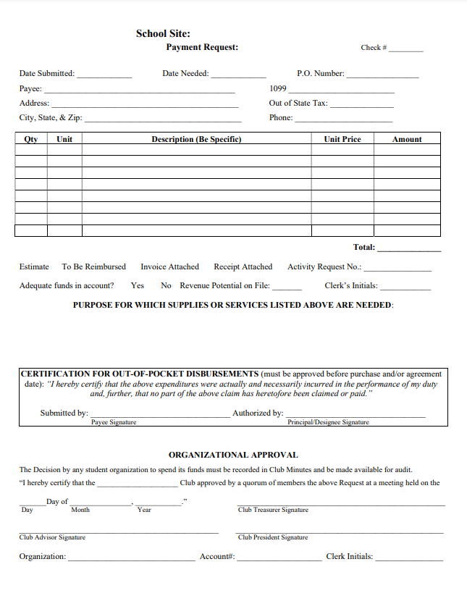
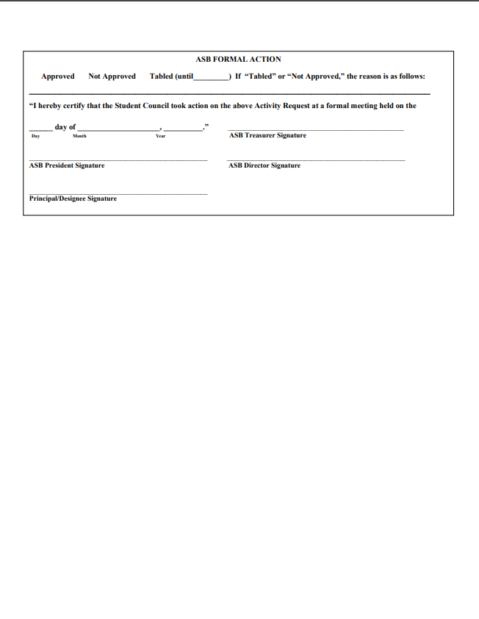
Payment Requests – Organized ASB
Payment Request Form
Tutorial Video

Slide 23
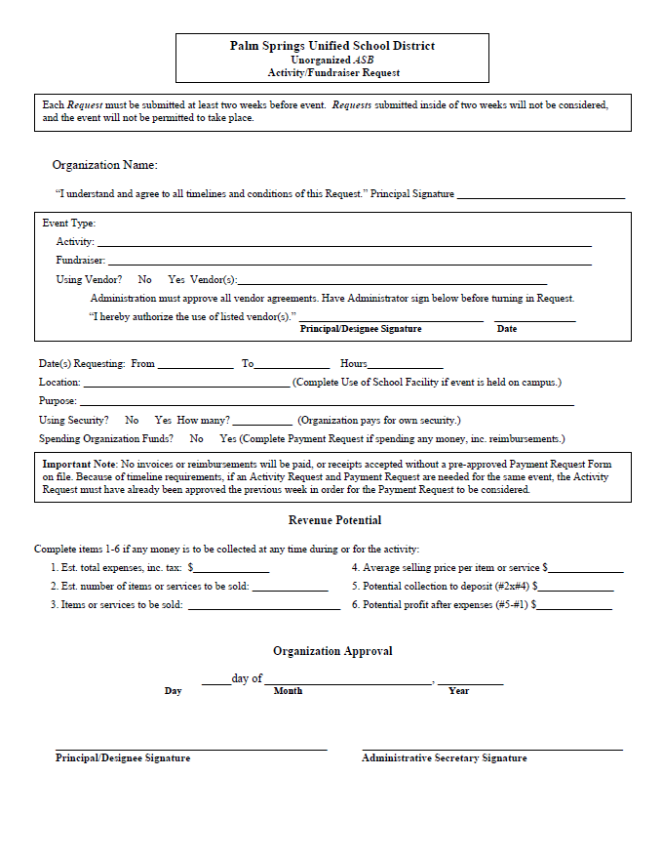
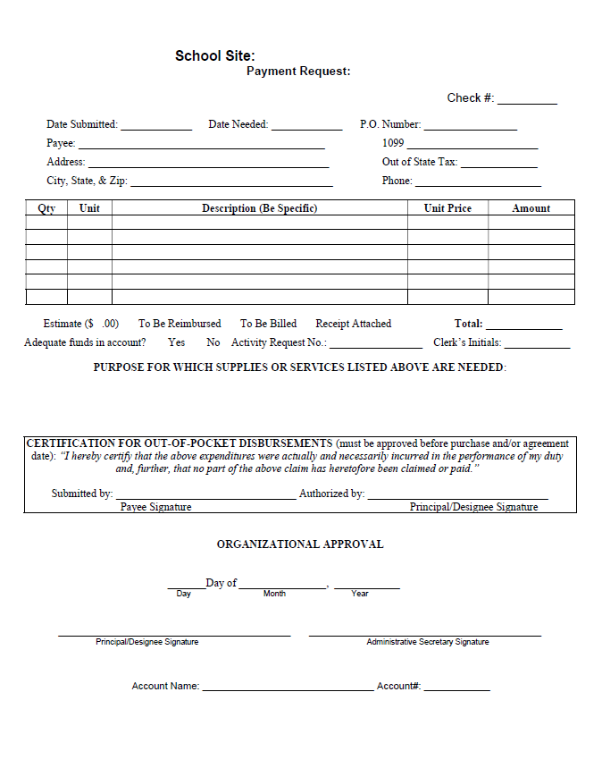
Request Forms – Unorganized ASB
Activity Request Form
Payment Request Form

Slide 24
Contracts
Chapter 15
ASB/USB must follow the policies and procedures for issuing contracts.
Examples of contracts:
  Dance DJ/Entertainment
  Magazine sale or other fundraiser
  Fieldtrip agreements (e.g.: Science Camp)
Contracts for vendors entering campus and vending machine contracts are always required to be reviewed and approved by Business Services or Purchasing.
  Request for Board Approval form

Slide 25
Contracts
Chapter 15, (continued)
Potential Problem Situations
Some ASB/USB organizations have found that the contracts they executed did not adequately protect their interests and the organization lost money.
ASB/USB organization also often find that the employee signing the contract did not have the authority to do so.
Please contact Purchasing Services at 760-883-2710 for contract assistance.

Slide 26
Cash Disbursement Management and Procedures
Chapter 18
An IRS form W-9 is required from all vendors before conducting business with the district.
Individuals and entities use form W-9 to provide their taxpayer identification number to entities that will pay them income during the tax year.
Vendors providing services totaling $600 or more to the ASB/USB will receive form 1099 (issued by the district) in January of the subsequent calendar year.

Slide 27
Cash Disbursement Management and Procedures
Chapter 18, (continued)
PSUSD High School ASB/USB need to keep track of all payments made to vendors providing services. This information is submitted to Fiscal Services each year, before leaving for winter break. An e-mail notification is sent out to High School ASB/USB clerks requesting the information. Based on the information obtained from the ASB/USB clerks, forms 1099 will be sent out to vendors accordingly by Fiscal Services.
Fiscal Services tracks all Middle School ASB/USB payments made to vendors for services and forms 1099 will be sent out to vendors accordingly by Fiscal Services.

Slide 28
Cash Controls and Fraud
Chapter 19
For everyone’s protection, do the following:
  Never leave money or checks unattended.
  Always count money with a witness and document that both parties verified counted amount.
  Always retain duplicate cash count forms for the club’s records.
  Reconcile bank statements on a monthly basis ensuring cash is available and club financial records are accurately reflected.
  Always provide a receipt to those depositing money.
  Provide monthly account summaries (revenues & expenses) to each club.
Notes:
Added: Reconcile bank statements on a monthly basis ensuring cash is available and club financial records are accurately reflected.

Slide 29
Cash Controls and Fraud
Chapter 19, (continued)
  Ensure that the ASB/USB bookkeeper is never afraid to ask questions. The ASB/USB bookkeeper should feel comfortable refusing an incorrect deposit or improper authorization for disbursement. Provide guidance and assistance as needed.
  Obtain proper authorizations for all transactions including journal entries, transfers, reimbursements and advances.
  Ensure disbursements are made after student council approval and all check requests contain all necessary signatures.
  ASB/USB deposits are to be picked up by armored carrier on a regular basis (depending on site). On very rare occasion, deposits are transported directly to branch offices by two people.
      SecTran is now or sole armored car service. We no longer have an agreement with Loomis.
Notes:
Added: Ensure disbursements are made after student council approval and all check requests contain all necessary signatures.

Slide 30
Cash Controls and Fraud
Chapter 19, (continued)
  Purchased items are verified and counted indicating all items are received and invoices/receiving documents are noted with an “OK to pay” or “received with a date”.
  Ensure that all tickets for sale are secured, master ticket log is updated and sales recap form contains explanations of any overages & shortages.
  Conduct monthly inventory counts and locate discrepancies and calculate ending valuations.
  Ensure that all club advisors retain club-related records for as long as they serve as club advisor.
Notes:
Added: Purchased items are verified and counted indicating all items are received and invoices/receiving documents are noted with an “OK to pay” or “received with a date”.
Ensure that all tickets for sale are secured, master ticket log is updated and sales recap form contains explanations of any overages & shortages.
Conduct monthly inventory counts and locate discrepancies and calculate ending valuations.

Slide 31
Record Retention
Record | Retention Period
ASB/USB Constitution, Bylaws and Charters | Permanent
Equipment Inventory | Permanent
Club and Council Minutes | 4 Years
Budgets | 4 Years
Invoices and Approval Documents | 4 Years
Banking Records | 4 Years
Financial Statements/Accounting Records | 4 Years

Slide 32
Food and Beverage on Campus
  The following applies to all food and beverage served or sold on any campus from 30 minutes before school starts to 30 minutes after then end of the school day.
  Sales must not compete with the school lunch program and may only be conducted by approved student organizations.
  Items sold must be approved by Nutrition Services prior to serving or selling to students to ensure compliance with Federal, State and Local regulations.
  All food and beverage served or sold on campus must comply with Health Department regulations.
  *For more details see the Nutrition Services Quick Reference https://www.cde.ca.gov/ls/nu/he/compfoodsrefpub.asp

Slide 33
Food and Beverage on Campus
(continued)
Elementary | Secondary (MS/HS)
Only one food or beverage item per sale. | Only one student organization per day is allowed to sell each day.
Sale must occur after the last lunch period. | Up to 3 categories can be sold. (beverage, snack, dessert).
Food or beverage item cannot be prepared on campus. | Food/beverage cannot be prepared on campus.
Each school is allowed only four sales per year. | Cannot be the same food sold during the noon meal service that day.
Cannot be the same food sold during the noon meal service that day. | Any and all student organizations may sell on the same four predesignated days per year.

Slide 34
Reconciliations and Internal Audits
High Schools and Alternative Schools
  Bank reconciliations must be completed monthly and submitted to Fiscal Services no later than the 20th of each month.
  Monthly audits starting in September 2023
      Sample selections of deposits and expenditures

Slide 35
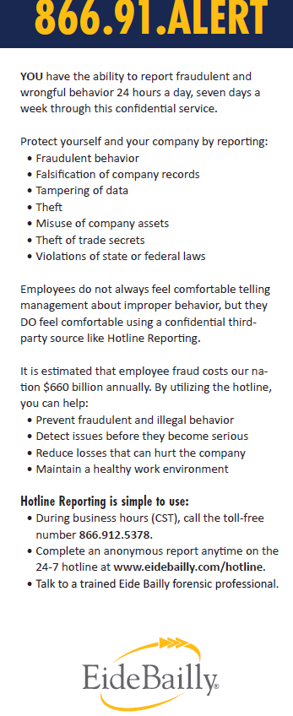
District Fraud Hotline
  Two ways to report suspected fraud
  www.eidebailly.com/hotline
  – or –
  Phone in at 1-866-912-5378
  Reporters may choose to remain anonymous or disclose their name.
  Each report will be reviewed by a third-party fraud investigation specialist.
  See handout for details.
Notes:
Added Fraud Pic

Slide 36
Teamwork Makes the Dream Work!
  Remember, the District is here to help!
  Tony Carrillo, Director of Fiscal Services
    (760) 883-2710 ext. 4806055
    tcarrillo@psusd.us
  Lesley Nichols, Accounting Supervisor
    (760) 883-2710 ext. 4806069
    lnichols@psusd.us
  CASBO Training Available: Legal Aspects & Hands-On Accounting for ASB

Slide 37

Questions?

