Slide 1
Stress and Anxiety
Lesson One

Slide 2
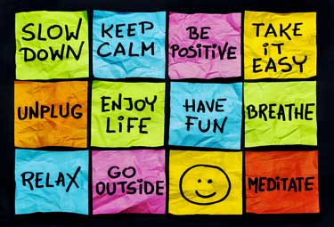
Learning Objectives: Lesson 1
Define stress and anxiety
Identify causes of stress and anxiety
Recognize how anxiety affects one’s body and what feelings describe anxiety
Demonstrate stress relievers

Slide 3
What is Stress? What is Anxiety?
Stress: is what you feel when you react to pressure, either from the outside world or from inside yourself. Stress is normal.
Anxiety: is a sign of stress overload.

Slide 4

ACTIVITY #1
Using the image of the soft drink machine, identify some different causes of stress and also what happens when the soda continues to flow into the cup and the person does not pull the cup away?

Slide 5
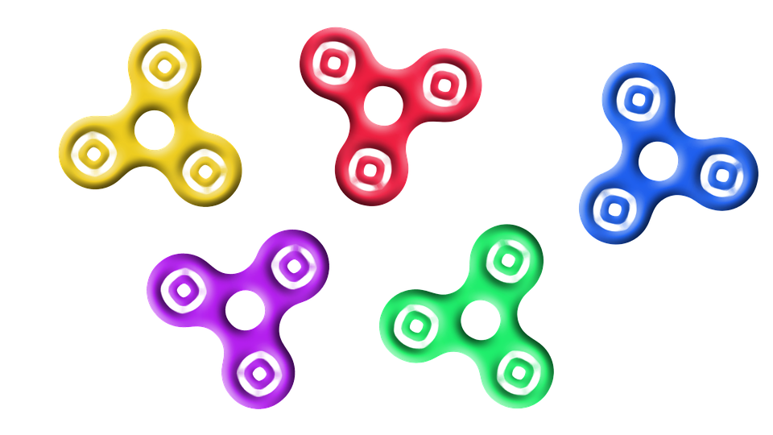
ACTIVITY #2
Label parts of the body where people might experience symptoms of anxiety
Outside the body outline, write down the words that you use (or have heard other people say) to describe those feelings of stress overload.

Slide 6
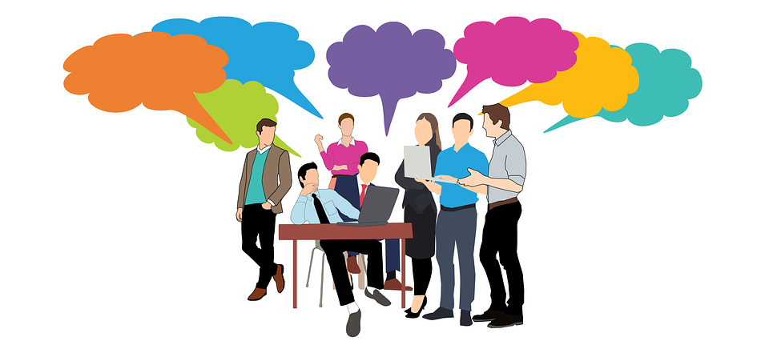
CLASS DISCUSSION
One of the skills we are learning and are going to practice is LOOK. Notice what your body is telling you or someone else.
Another skill we are learning and will practice is LISTEN.
What are the words that you might hear a friend say about stress and anxiety?

Slide 7

STRESS-RELIEVERS
Positive Mental Messages
Stenching
Deep Breathing
In what situations could you use these skills?

Slide 8

Positive Mental Messages
Can you think of a negative mental message?
“I’ve got so much homework; I’ll never get it done.”
Sending yourself this kind of mental message can actually increase your anxiety level
How can you make you change this message so it is positive and can make you feel more peaceful?
How about this: “Those kids are laughing; they must be laughing at the way I look.”
How could you change that to a positive message?
Try paying attention to your mental messages over the next few days.

Slide 9

Stretching is another stress reliever
Stand up on your tiptoes and stretch your arms straight above your head - toward the ceiling.
Hold that position to the count of 10.
Put your arms down and your feet flat on the flow.
Lift up your shoulders without moving your head and hold that position.
Relax and roll your head so your left ear is touching your left shoulder; then roll your head so your right ear is touching your right shoulder. Let’s do that five times.

Slide 10

Deep Breathing
Take a really deep breath that makes your chest expand.
Hold it for five seconds and then let it out.
It’s okay to make noise as you exhale.
Try again 4-5 times

Slide 11

Wrap Up
What is the point of doing these exercises
Your homework tonight is to teach someone one of these stress relievers

Slide 12
Dealing with Stress and Anxiety
Lesson 2

Slide 13
Lesson 2: Learning Objectives
Identify 3 healthy ways to deal with stress including what they involve and the advantages of each
Look and listen for stress or anxiety in a friend’s instant message (IM)
Link a friend to a particular stress reducer and explain reasons for that suggestion

Slide 14

Recap Lesson 1
Your homework assignment
What are some unhealthy ways to deal with stress?

Slide 15
not going to school
staying in your room
hitting things or people
picking fights
drinking, smoking, doing drugs
spreading rumors
stop hanging out with friends
eating too much
sleeping too much
yelling at friends or family

Slide 16
Healthy ways of dealing with Stress
Talking it out: talking about feelings, ranting or venting with someone you trust, face-to-face, electronically or over the phone
Problem Solving: figuring out different solutions and consequences of each. Sometimes there are a lot of problems going on at one time so you have to break each one down by itself
Example: Your big science project is due in two days. You’ve had two weeks to work on it, but you started. How are you going to solve this problem?

Slide 17
Possible Solutions and Consequences
Stay up late for the next two nights and get it done
What’s the consequence:
Just do what I can, but not worry about finishing
Plead with my teacher for an extension
Beg my dad to do it for me?

Slide 18
Healthy ways of dealing with Stress
Relaxation exercises like stretching, breathing, yoga, meditation, visualization
Distractions/hobbies
Keeping your body healthy: SELF - sleep, exercise, leisure, food

Slide 19



Activity 1: Sportsaholic: Look, Listen, Link

Slide 20

Activity 2: Group Activity

Slide 21
Teen Depression
Lesson 3

Slide 22
Lesson 3: Learning Objectives
Define depression and name some of its causes
Understand the facts about teen depression
Recognize what a depressed friend might look like, sound like, and feel like
Distinguish between what adults and friends can do for a depressed teen

Slide 23

Lesson 3: Teen Depression
Depression: A person can be born with genes for depression or can develop depression. Stress overload and the inability to manage it can lead to depression
Question:
What do you think are some causes of teen depression?

Slide 24
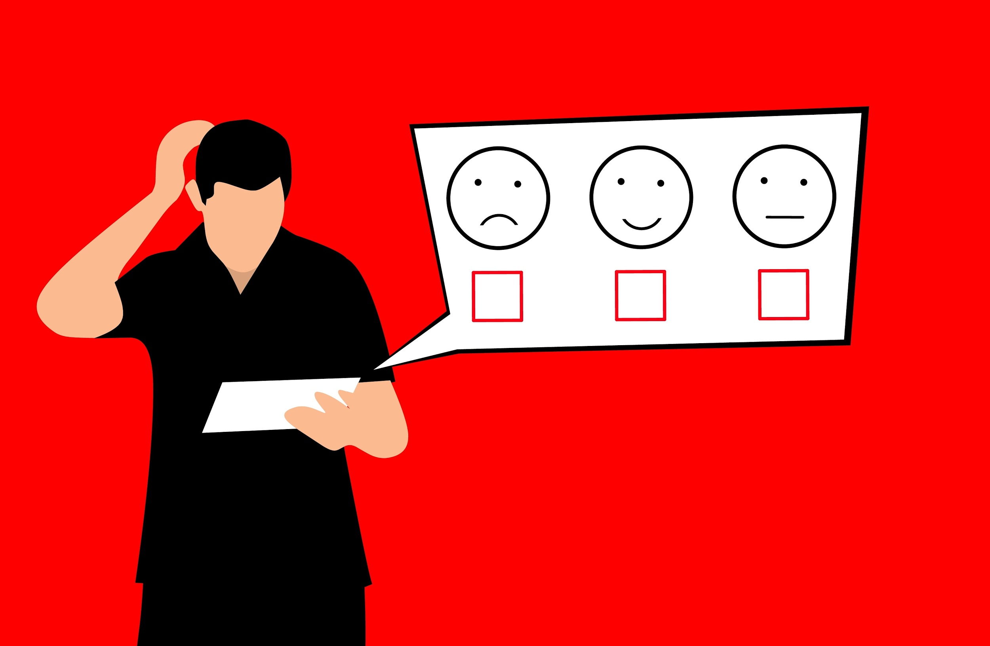
Activity 1: Anonymous Depression Survey

Slide 25
Activity 2 : Depression worksheet: Look, Listen, Link

Slide 26
Suicide Prevention Skills Practice
Lesson 4

Slide 27
Lesson 4: Learning Objectives
Describe the difference between depression and being suicidal
Identify signals that a friend might need help
Describe the rationale for linking a troubled friend to an adult
Name adult resources in school and community

Slide 28
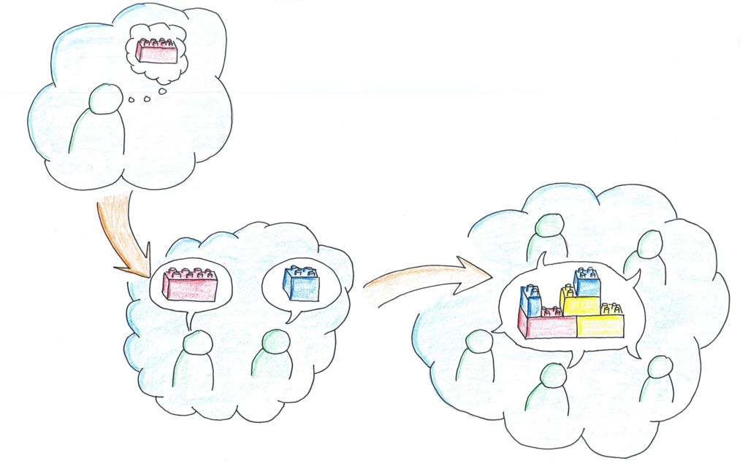
Think, pair, share
Not everyone who is depressed thinks about suicide.
What is the difference between depression and being suicidal?

Slide 29

Activity 1: Maze Escape

Slide 30

Link
One way out of hopelessness is to link to other people

Slide 31
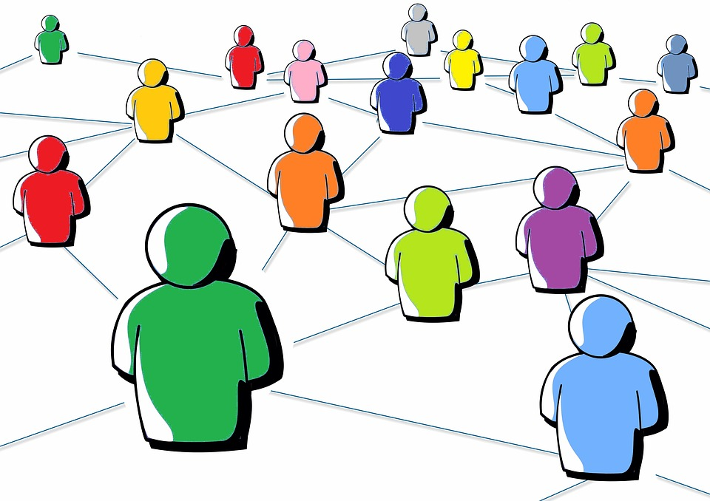
People you can link
Parents/Stepparents
Friends’ parent
Family members
Pastor
Principals
Teachers
Coaches
School counselors
Crisis lines or help lines 1-800-273-TALK

Slide 32
Think Pair Share
What are some warning signs that a teen might be thinking about suicide?

Slide 33
Warning signs that a teen might be thinking about suicide?
Drinking alcohol or doing drugs
Talking or joking about suicide
Saying things like, “I’d rather be dead” “I wish I could disappear forever,” or “There’s no way out.”
Talking about death in a positive or idealized way (‘If I die, people might love me more”)
Stories, poems, or artwork about death, dying or suicide
Engaging in reckless behaviors
Giving away prized possessions
Saying goodbye to friends and family as if for good
Seeking out or researching methods of suicide

Slide 34
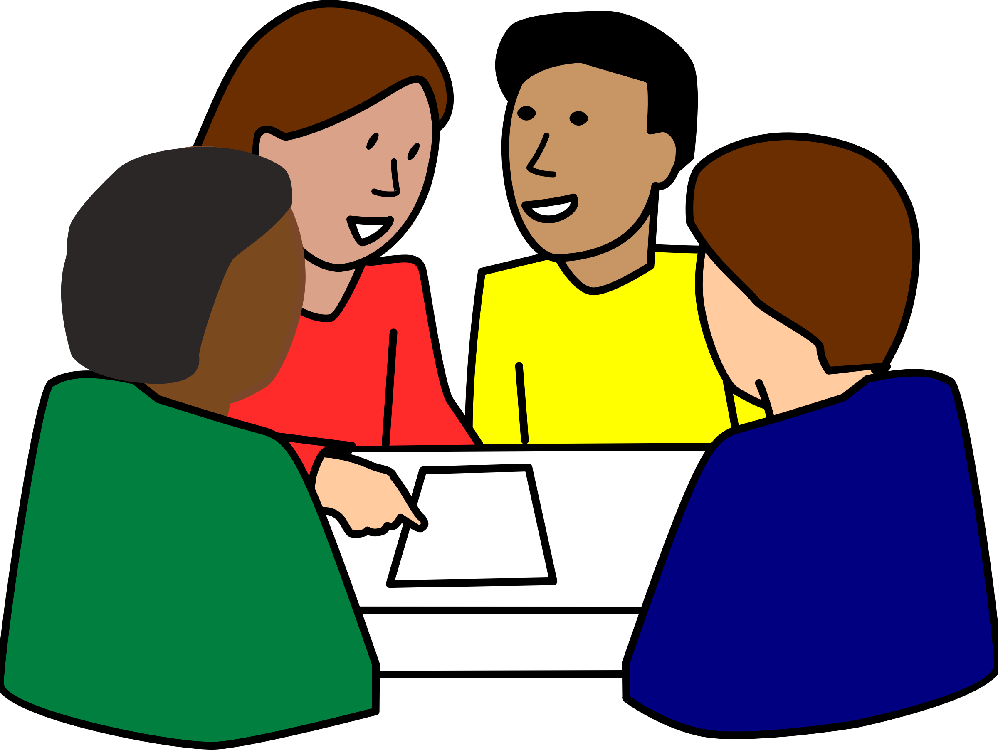
Activity 2: Scenario Worksheet
In small groups of 4 students
Student 1: Reader
Student 2: Scriber
Student 3 and 4: Reporters

Slide 35

Activity 3: Demonstration Role Play
(1 ) Upset Friend
(2) Helper Friend #1
(3) Helper Friend #2
(4) Adult

Slide 36
Activity 4: myLINKS Resource Cards
What adults would you go for yourself or a friend?
Write their names and their contact information on your card
Write down this resource, the suicide hotline phone number:
1-800-273-TALK

